Slide 1
Formal Methods in Software Engineering

Slide 2
What is Temporal Logic?
Objective: We describe temporal aspects of formal methods to model and specify concurrent systems and verify their correctness properties.
In concurrent reactive systems, correctness not only validates the correct input and output of the computational system, but also objectively monitors the execution of the system.
Temporal logic is explicitly developed to treat these aspects and to monitor infinite behavior of reactive systems.
,

Slide 3
What is Temporal Logic?
Temporal logics have played vital role in formal verification wherever needed to state the specification requirements for hardware and software systems.
Time: It represents the set of rules for reasoning in terms of time and the time domain is expressed in terms of state.
A present time corresponds to current state and next moment of time corresponds to the immediate next state.
Alternatively, system behavior is observed in terms of discrete time points such as 0, 1, 2,….., n.

Slide 4
What is Temporal Logic?
Transition: Transition corresponds to the progressions from current time step to the next time step with specific action.
Temporal logic is applicable due to its behavioral aspects of hardware and software in terms of time.
Reasoning in the temporal logic is much easier with the translation into the predicate calculus because relationship among time is implicit manner.

Slide 5
Temporal Logic Operators
Temporal logic has introduced some additional operators that represent the time variable and reflect their relationships.
In essence, temporal logic is an extension of propositional logic. It is also known as propositional temporal logic (PTL).
With the set of temporal operators, these enable the definition of formulas with the accessibility relation.
When defining temporal properties, some temporal operators are needed to model the system in terms of time.

Slide 6
Temporal Logic Operators
These operators include
  F ----- Future or eventually
  G ---- Globally
  X ------ Next
  U ------ Until
The first three operators are unary whereas the last one is binary

Slide 7
Computational Paths, System run
Define in terms of states and transitions
A sequence of states, starting with an initial state
  s₀ s₁ s₂ … such that R(s_{i}, s_{i+1}) is true
Also called “run”, or “(computation) path”
Trace: sequence of observable parts of states – Sequence of state labels

Slide 8
Core Properties of Temporal Logic
Safety property means “something bad must not happen”. E.g.: system should not crash.
Liveness property means “something good must happen”. E.g.: every packet sent must be received at its destination
Guarantee of Service states that if one process sends a request, it must have to be responded by other process.
Mutually exclusion occur when two processes execute concurrently at the same critical section. Then, it is prescribed as “bad thing”.

Slide 9
Temporal Logic Types
There are two types of temporal logics, each having their own temporal operators.
In linear time temporal logic, there is a single successor state at each moment of time
Branching time temporal logic, time is split into different alternative paths.

Slide 10
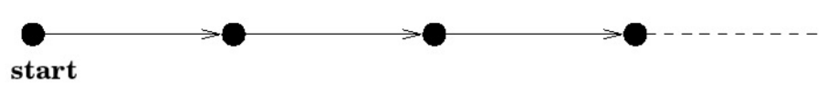
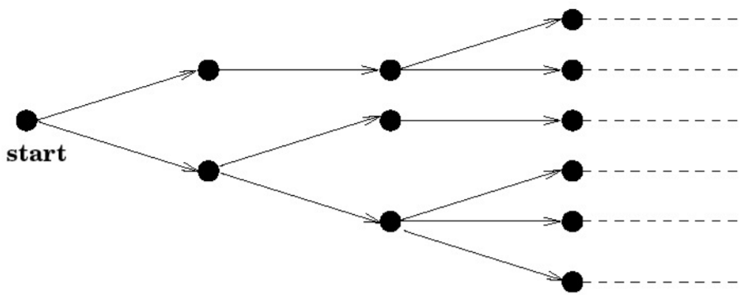
Temporal Logic Models
Linear Time Temporal Logic
Branching time temporal logic

Slide 11
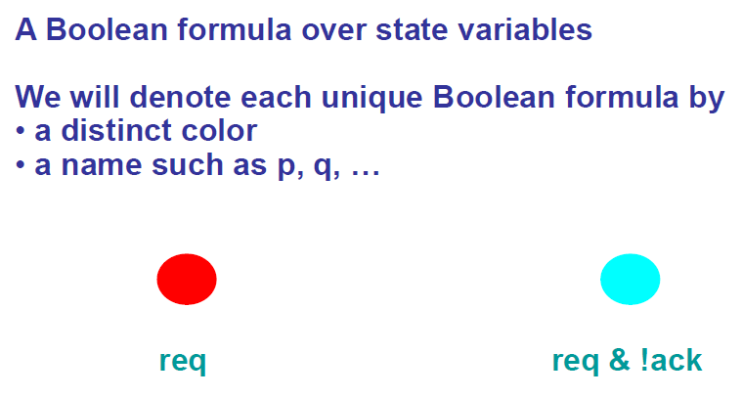
Temporal Logic Operators

Slide 12
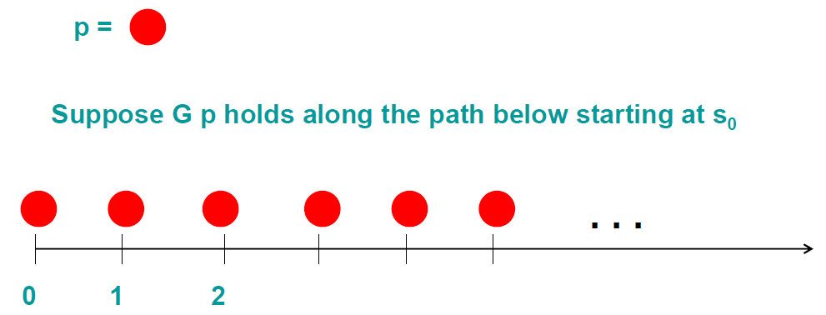
Temporal Logic Operators
Globally (Always) p: G p
  G p is true for a computation path if p holds at all states (points of time) along the path

Slide 13
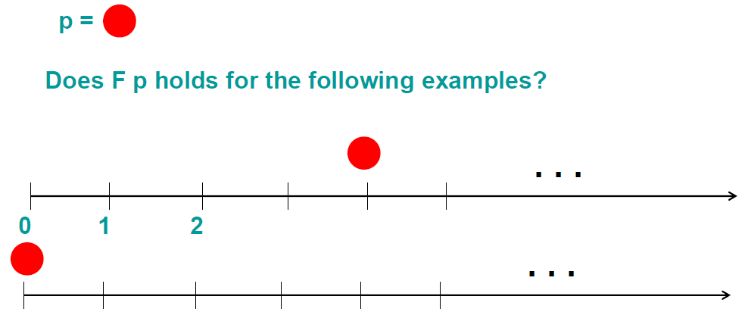
Temporal Logic Operators
Eventually p: F p
F p is true for a path if p holds at some state along that path

Slide 14
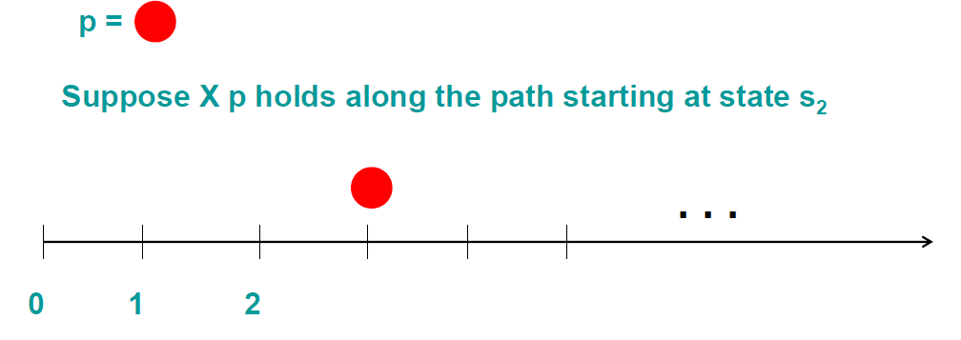
Temporal Logic Operators
Next p: X p
X p is true along a path starting in state s_{i} (suffix of the main path) if p holds in the next state s_{i+1}

Slide 15
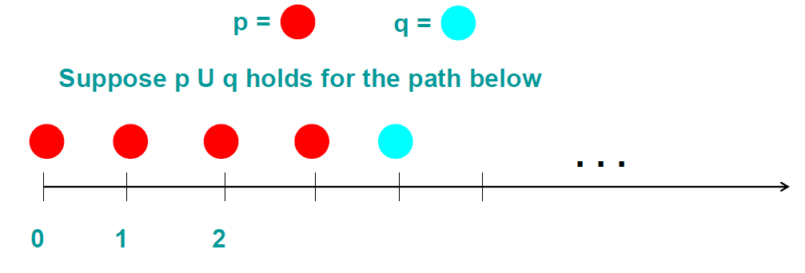
Temporal Logic Operators
p Until q: p U q
p U q is true along a path starting at s if
  q is true in some state reachable from s
  p is true in all states from s until q holds

Slide 16
Temporal Logic Operators
Examples: What do they mean?
G F p
F G p
G( p → F q )
F( p → (X X q) )

Slide 17
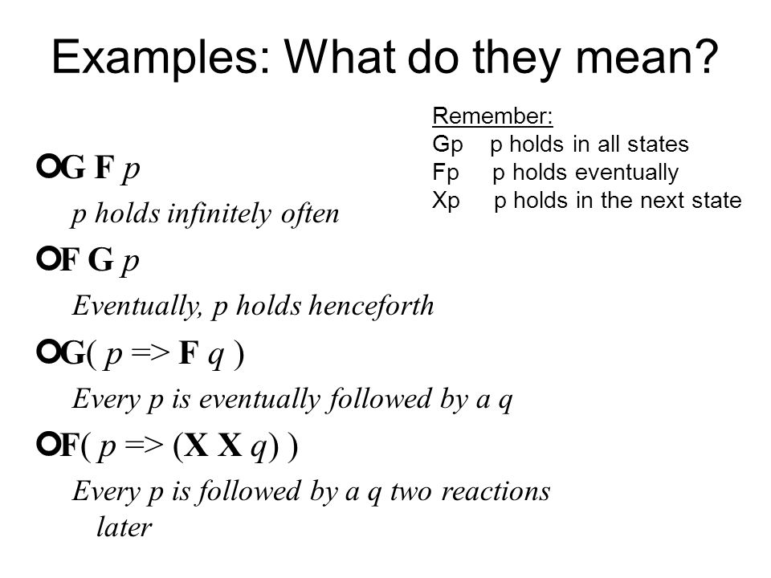

Slide 18
Whenever the iRobot is at the ramp-edge (cliff), eventually it moves 5 cm away from the cliff.” p – iRobot is at the cliff q – iRobot is 5 cm away from the cliff
G (p => F q)
“Whenever the distance between cars is less than 2m, cruise control is deactivated” p – distance between cars is less than 2 m q – cruise control is active
G (p => X ! q)
Example

Slide 19
Linear Time Temporal Logic (LTL)
Linear Temporal Logic has been proposed as a formal verification tool by Amir Pnueli.
LTL models time as a sequence of states and the future state is seen as a path in LTL.
Accordingly, there are different future paths from where any path is taken as an actual path.
There are many LTL model checking tools available which use LTL as a property specification language

Slide 20
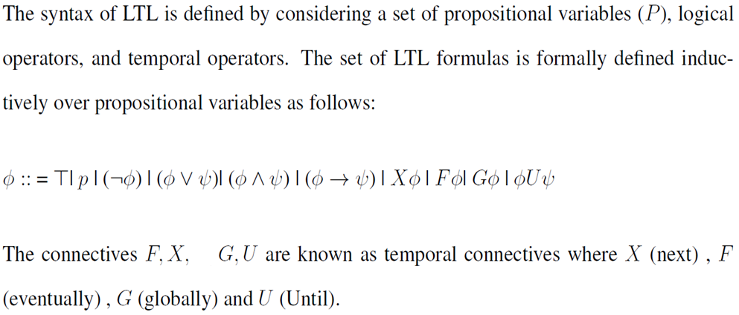
LTL Syntax

Slide 21
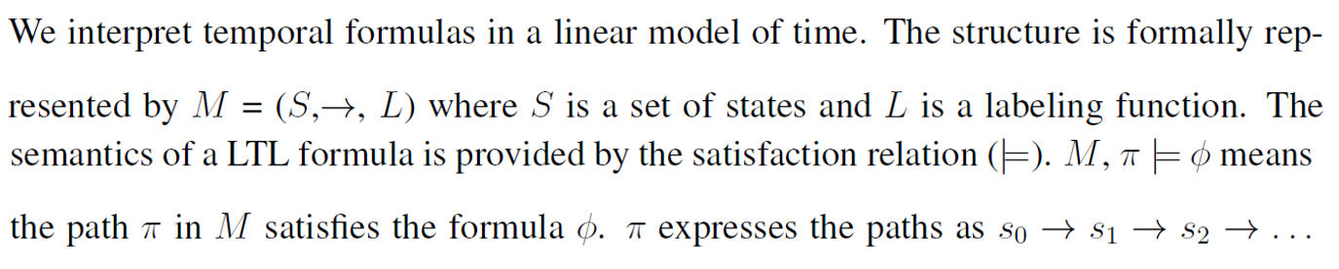
LTL Semantics

Slide 22
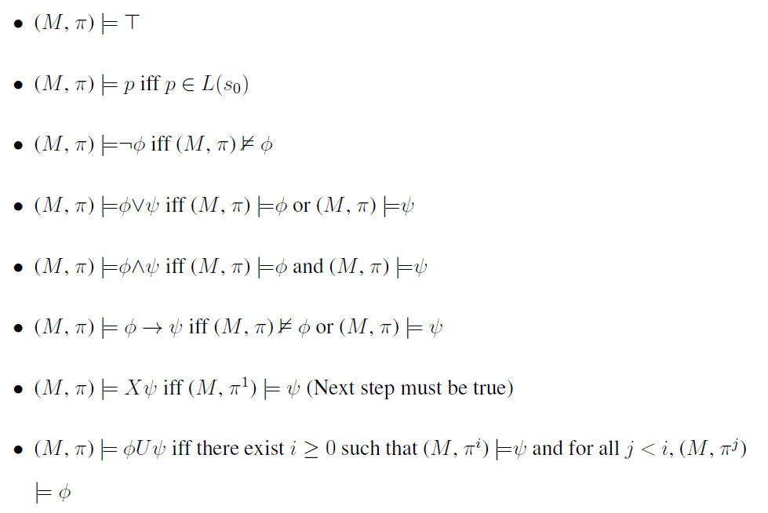
LTL Semantics
The semantics is defined by induction on the structure of ⱷ, is given as:

Slide 23
Computational Tree Logic (CTL)
CTL is a branching time temporal logic.
Like LTL, it is also used in formal methods to verify correctness properties of a system by model checking tools.
CTL is more expressive than LTL and permits quantification over path

Slide 24
CTL
Each state may have an accessibility relation with the immediate next state by a transition which reflects the system behavior in terms of time.
Properties expressed over a tree of all possible executions

Slide 25
LTL Vs CTL
LTL (linear-time logic)
  Describes properties of individual executions.
  Semantics defined as a set of executions.
CTL (computation tree logic)
  Describes properties of a computation tree: formulas can reason about many executions at once. (CTL belongs to the family of branching-time logics.)
  Semantics defined in terms of states.

Slide 26
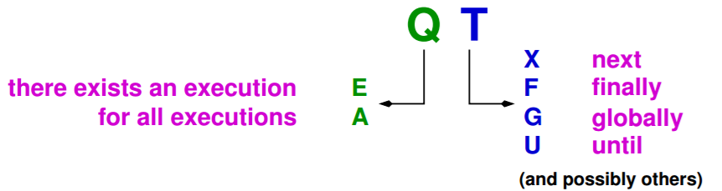
CTL Operators
In CTL, each temporal connective is a pair of symbols.
The first symbol in a pair is one of the E and A.
  E means along at least one path, and
  A means along all paths.

Slide 27


CTL operators
CTL operators are used with logical operators in the same way as with other logics, these operators are: ,
The operators X, F, G and U cannot appear without an E or an A in CTL.
CTL basic operators:
  AX and EX,
  AG and EG,
  AF and EF,
  AU and EU

Slide 28
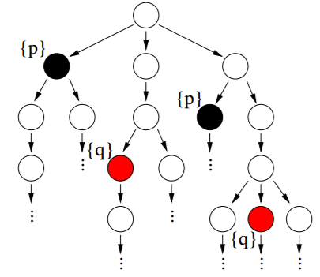
CTL Example
Let’s see an example system, how system flows in branching time temporal logic
We assume
  p = black ball
  q = red ball

Slide 29
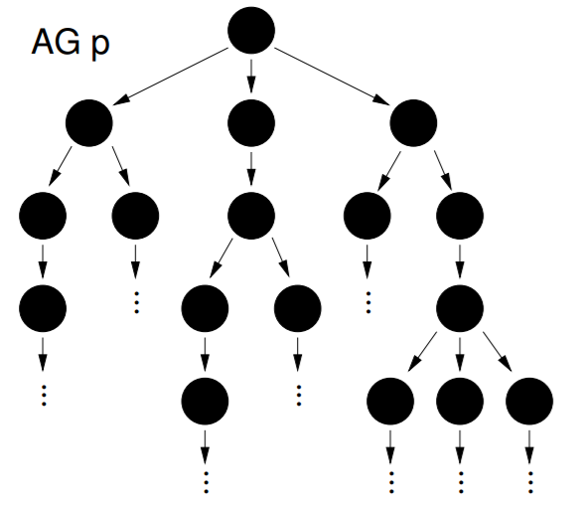
A formula p appears globally on all paths

Slide 30
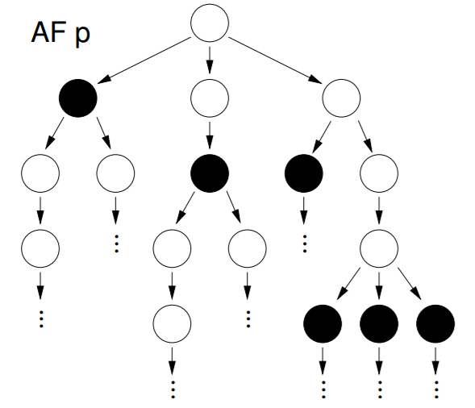
A formula p appears eventually on all paths

Slide 31
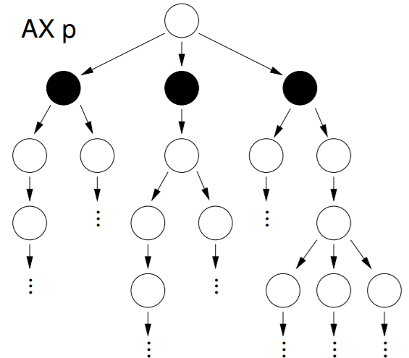
A formula p appears in the state on all paths

Slide 32
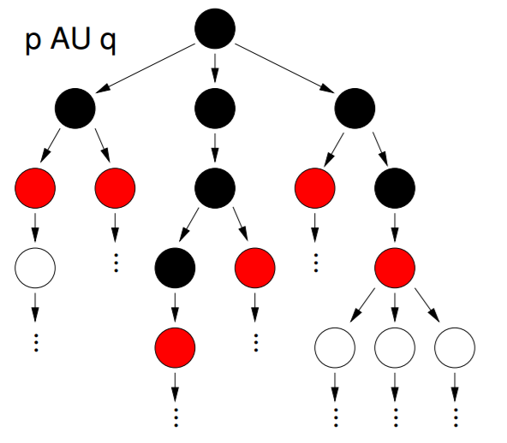
A formula p appears on all paths until q appears

Slide 33
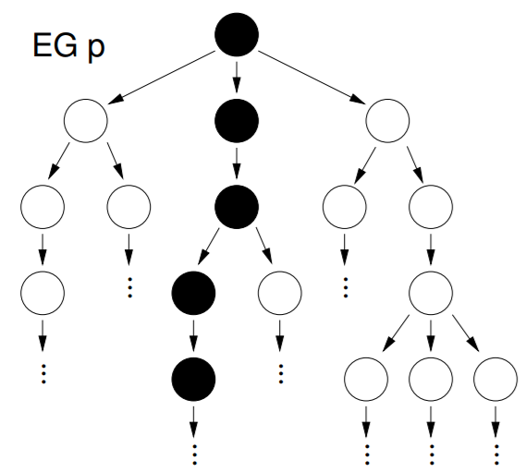
A formula p appears globally on any path

Slide 34
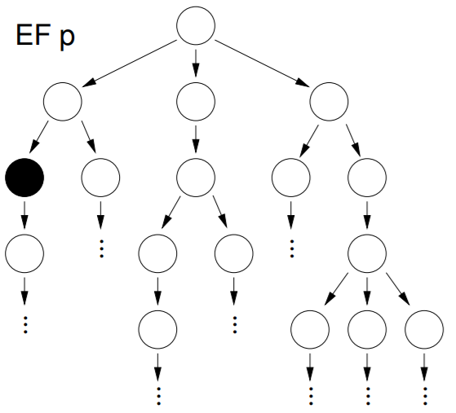
A formula p appears eventually on any path

Slide 35
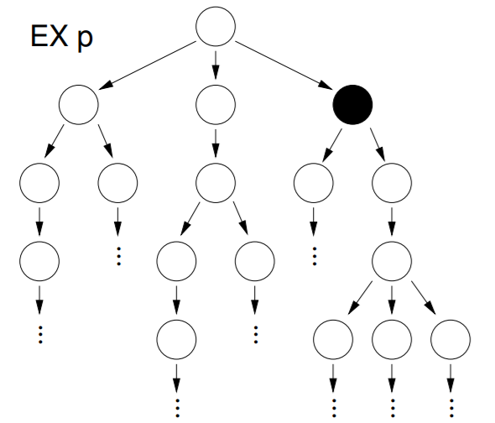
A formula p appears on the next state of any path

Slide 36
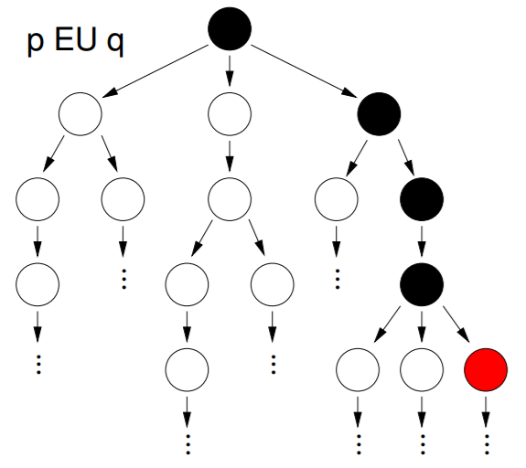
A formula p appears on any path until q appears

Slide 37
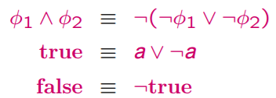
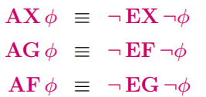
CTL formulas Equivalence

Slide 38
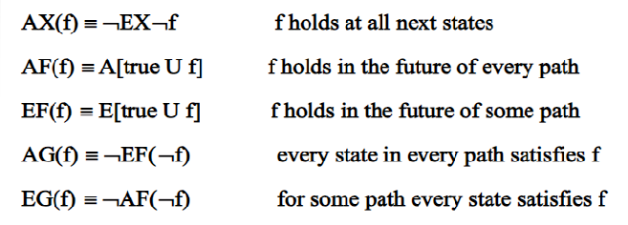
CTL formulas Equivalence

Slide 39
CTL Syntax
The syntax of CTL is defined by considering a set of propositional variables (P), logical operators, and temporal operators.
The set of CTL formulas is formally defined inductively over propositional variables as follows
Where p Є P

Slide 41
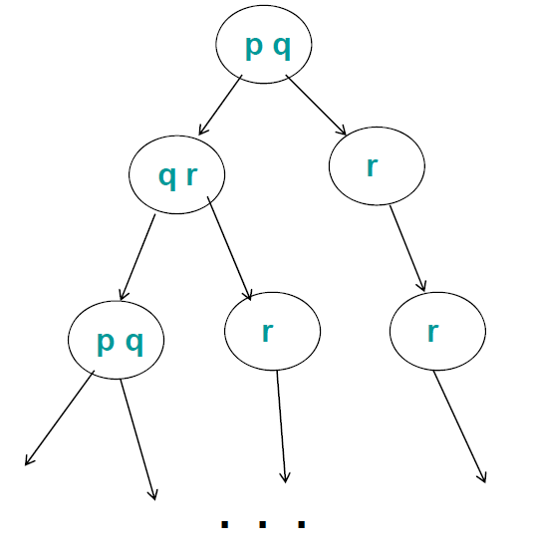
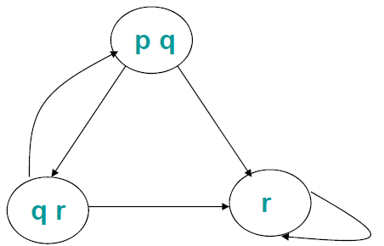
Transition Graph (Labelled States)
Kripke Structure
Infinite Computation Tree

Slide 42
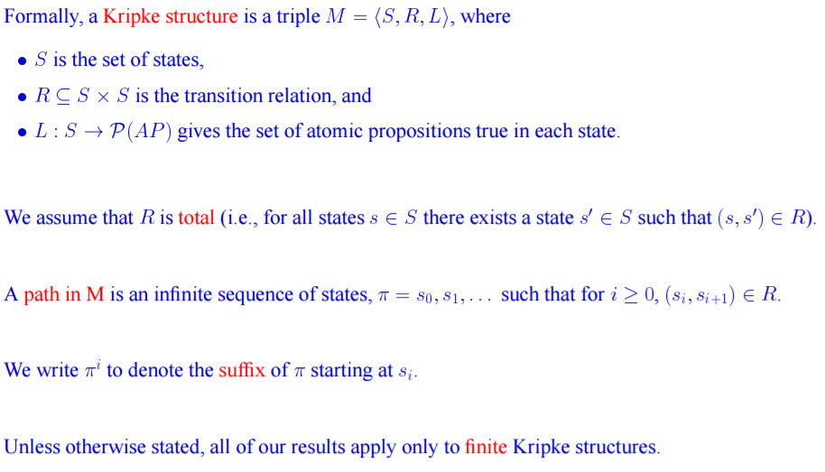
Kripke Structure

Slide 43
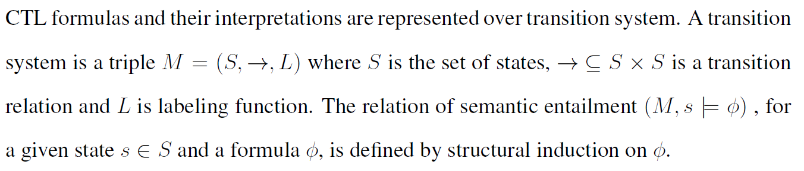
CTL Semantics

Slide 44
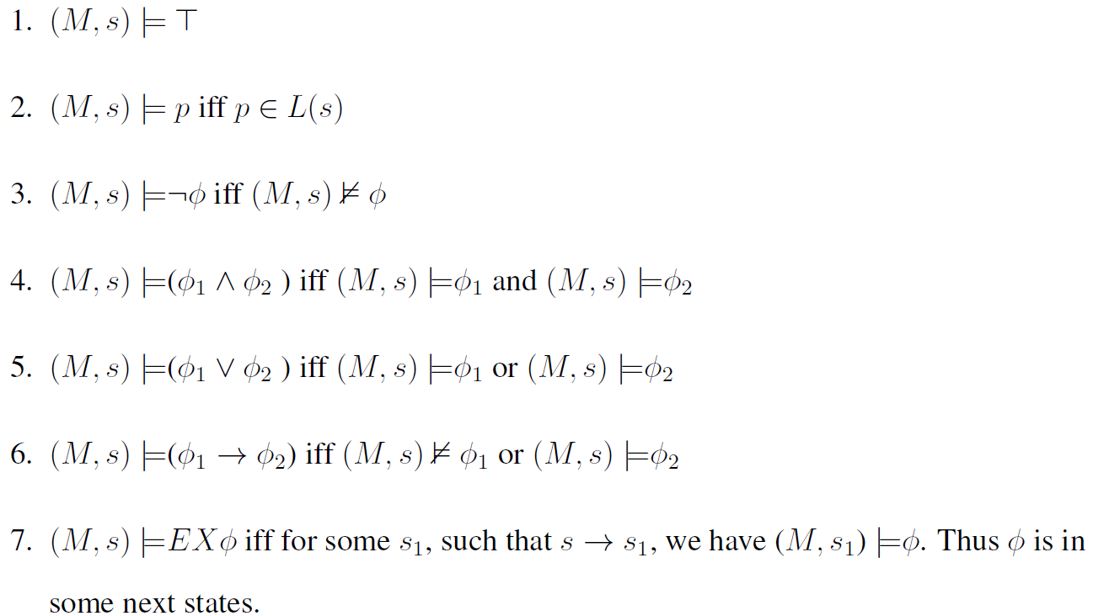
CTL Semantics

Slide 45
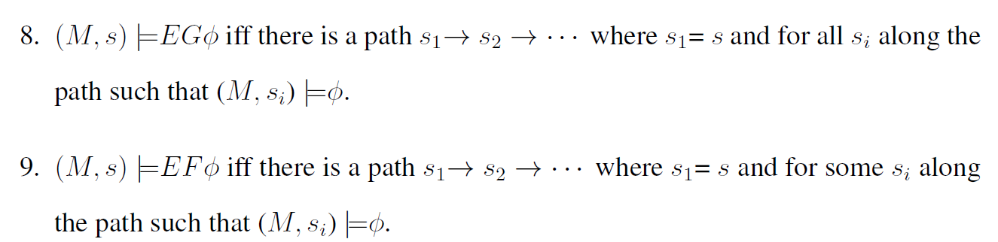
CTL Semantics

Slide 46
Thanks

